Slide 1

A Project on Retail Superstore

Slide 2
1. Introduction
This project is about a retail store which sales products all over the world. The products are primarily furniture's, office supplies and appliances. The customers are broadly classified into three main categories i.e individuals, home office and corporate.
The data set available contains four years sales, quantities, shipping cost and profit.
Main outcome of the project;
An automated process created which can be offered to a small or medium size organization having minimum resources to get the sales analysis report on daily/weekly/monthly basis without investing in expensive manpower and technology.
A supervised machine learning model developed to facilitate prediction of future sales which can help management in taking decision on purchasing inventories to maintain inventory level in the retail stores.
------ sounds interesting right? Please follow along to see how did we do this;

Slide 3
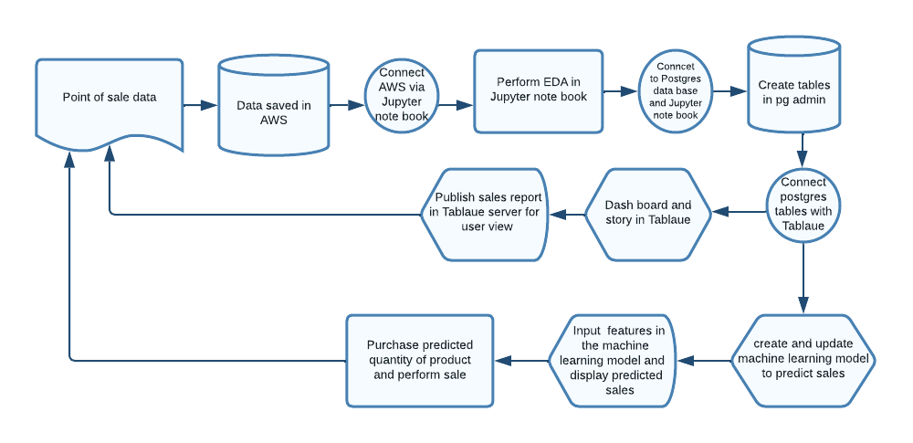
Process flow chart

Slide 4
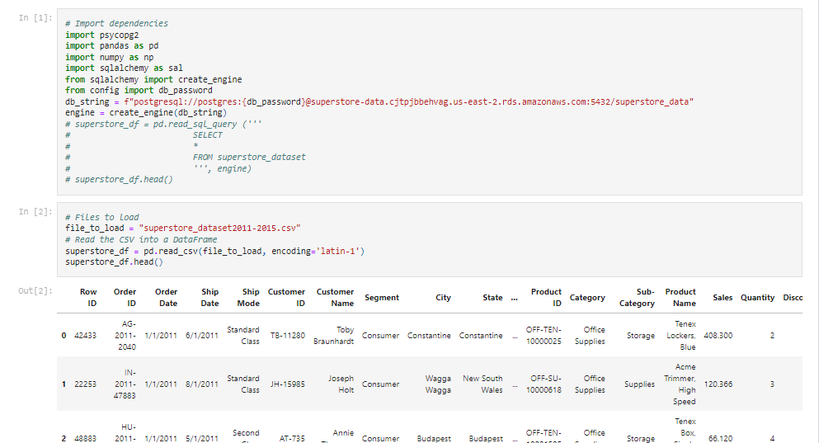
2.1 Demonstration of the process with dummy data set
We have used Kaggle.com to retrieve data set of a retail store which contains fours years sales data.
We saved data in AWS and established connection in jupyter notebook to retrieve data from AWS with below simple codes.
After data retrieval, we have performed few data cleaning to make the data ready to be exported to postgres sql.

Slide 5
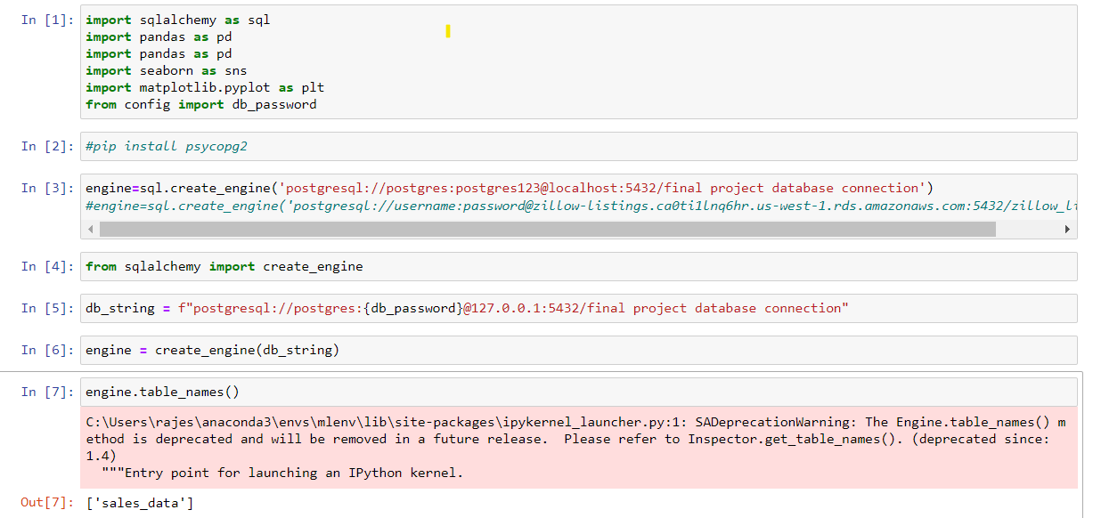
2.2 Created a connection between Jupyter notebook and postgres sql to export cleaned data set from Jupyter notebbok to postgres sql.
A screen shot of connection from Jupyter note book to Pg admin

Slide 6
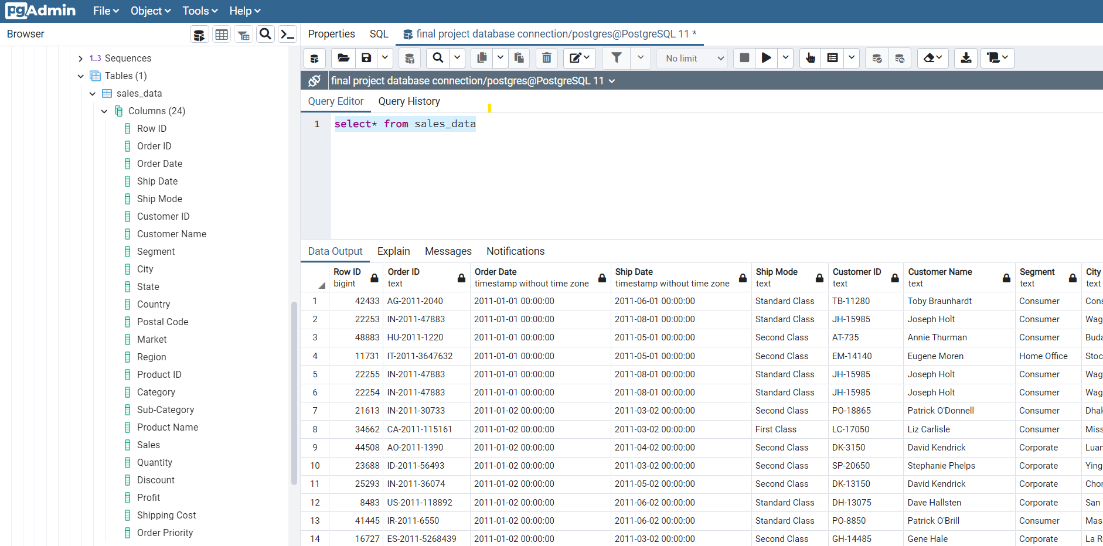
A screen shot of data base created in Pg admin through engine created in Jupyter notebook

Slide 7
2.3 Visualize sales in Tableau
We have created a connection in Tablaue to tables in postgres sql to visulaize sales and listen to the stories
https://public.tableau.com/views/superstore_sales_analysis_16681333746150/Superstore_Sales_Profit_Analysis?:language=en-US&publish=yes&:display_count=n&:origin=viz_share_link

Slide 8
3 Machine learning model to predict sales
The clean data set generated in postgres sql is used to create a machine learning model.
We have used multiple regression model to predict sales – lets check out flask to see how it works;

Slide 9
4 Front end
We have developed a website which will be used to reach prospective users.

